Slide 1
JFK Courier Service Company
GROUP 4

Slide 2
AGENDA
Company Background
Business Overview
Data Model Design/ERD
Database Creation
Report Examples

Slide 3
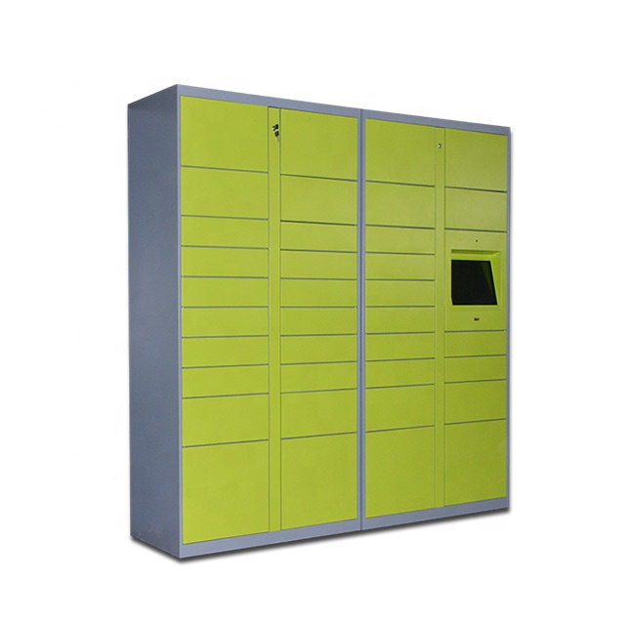
COMPANY BACKGROUND
1、The "Express Management Terminal" designed for property companies, community owners, courier companies, industry users, and e-commerce companies focuses on smart courier services, which is convenient and fast.
2、JFK Express Delivery System is a unified online management system customized by Fengchao Technology for enterprises, industrial park management offices, community property management offices, etc. It provides a common delivery solution of cabinet + point + person to solve single delivery. The high labor cost of collection management and other issues.

Slide 4

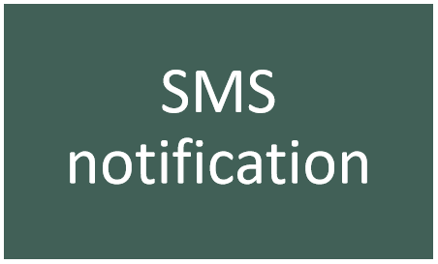
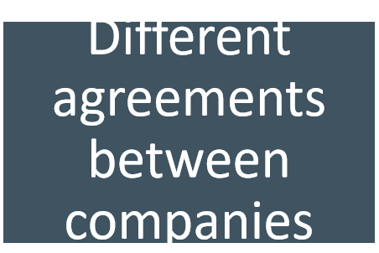

BUSINESS OVERVIEW-Pain Points and Enablers

Slide 5
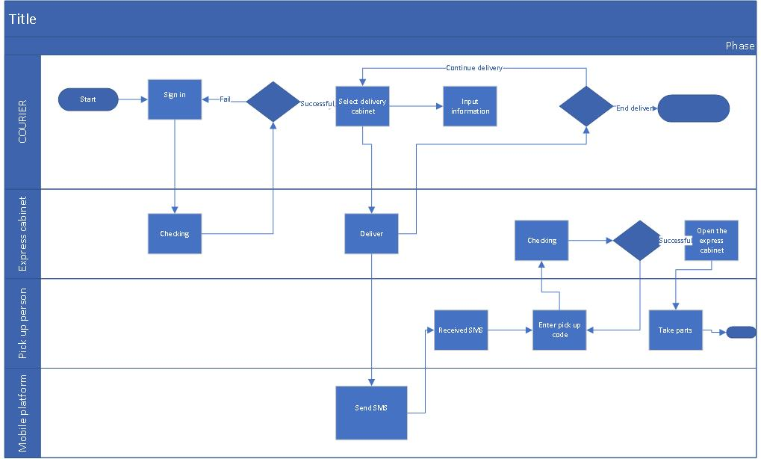
BUSINESS OVERVIEW-Process Flow “As is”

Slide 6
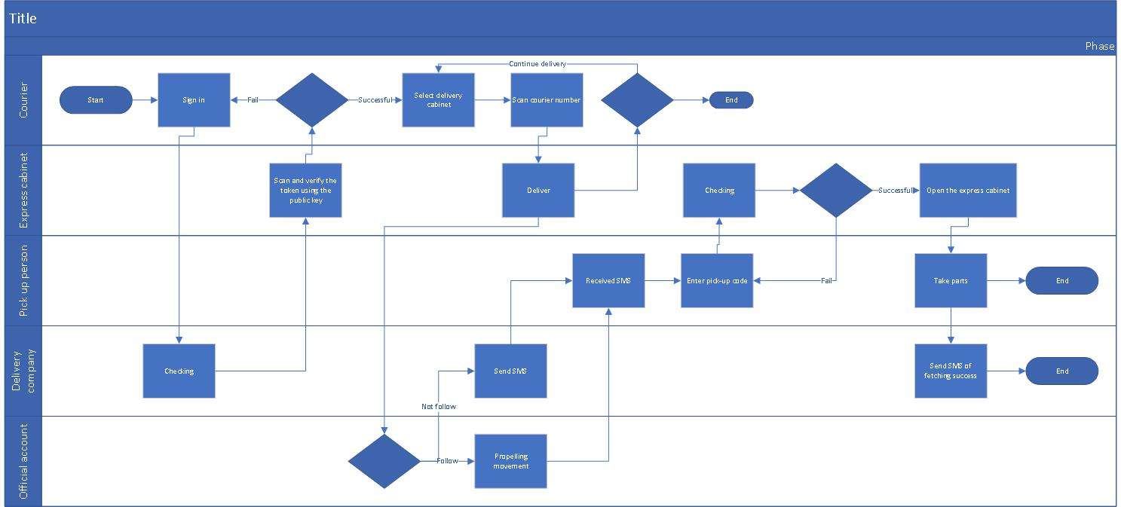
BUSINESS OVERVIEW-Process Flow “To be”

Slide 7
BUSINESS OVERVIEW-Future State Process Benefits
Perfect fusion of multiple functions
1、For consumers and users
Multi-channel, diversified express delivery
Multiple payment methods
2、For express service station (express cabinet)
Unified and precise management Online payment
Order printing
Accurate and clear reconciliation and settlement
3、For courier system
Hardware support and stable operation

Slide 8
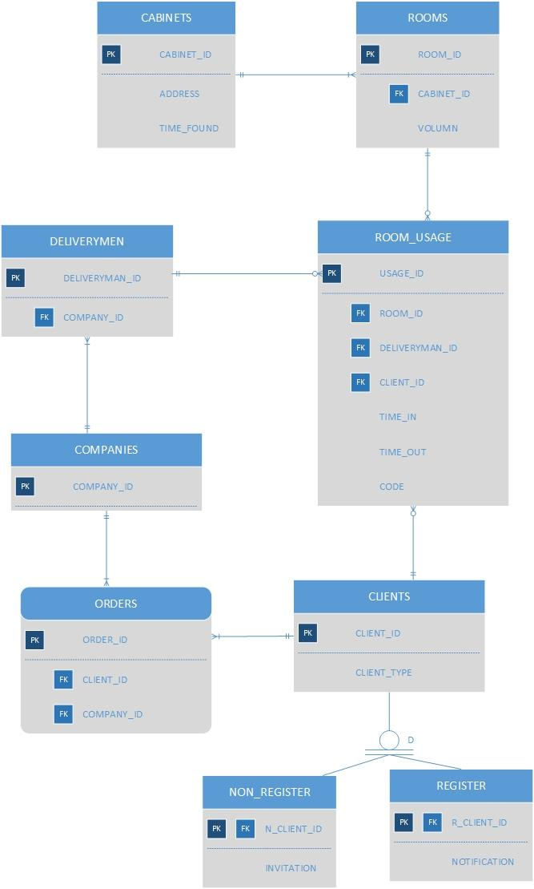
BUSINESS RULE & ERD
For the new business process, JFK company needs to track the information of every usage of their cabinets to help them control and monitor the process.
Every time the the cabinet was used by a delivery man under the cooperative delivery company. The JFK company needs to record all the related information like the delivery man’s information, the client’s(pick up person) information and etc.
Also the JFK company needs to send the pick up code to the clients, so they also need to know if the client has signed up their account.

Slide 9
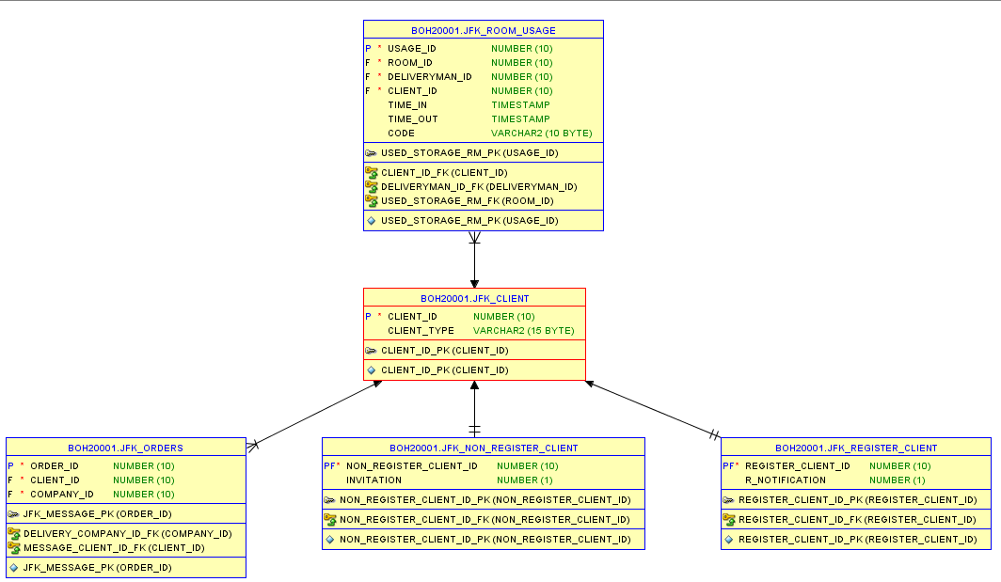
DATABASE CREATION
Create nine different tables
Define different columns for tables
Add PKs and FKs for these tables

Slide 10
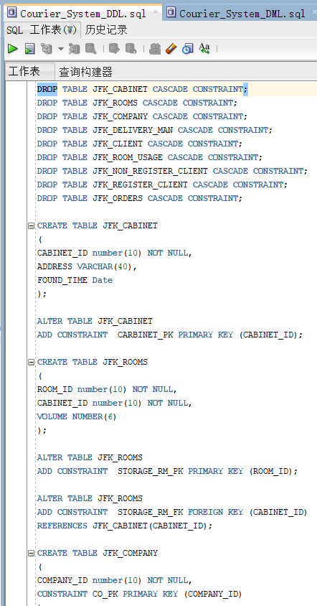
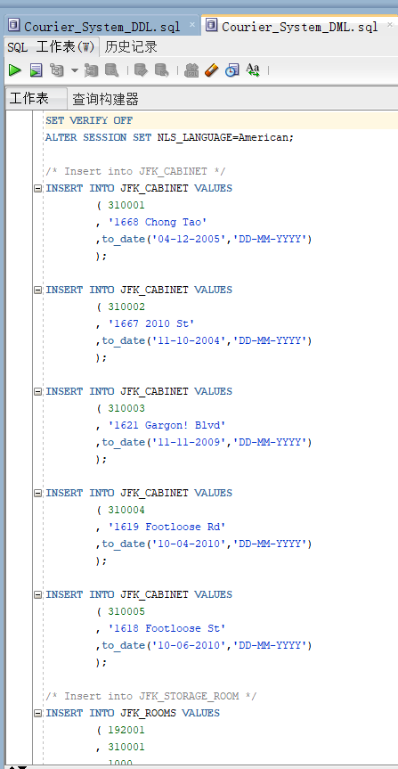
DATABASE CREATION
Inserted at least 10 rows for tables
encapsulated SQL code into two files

Slide 11
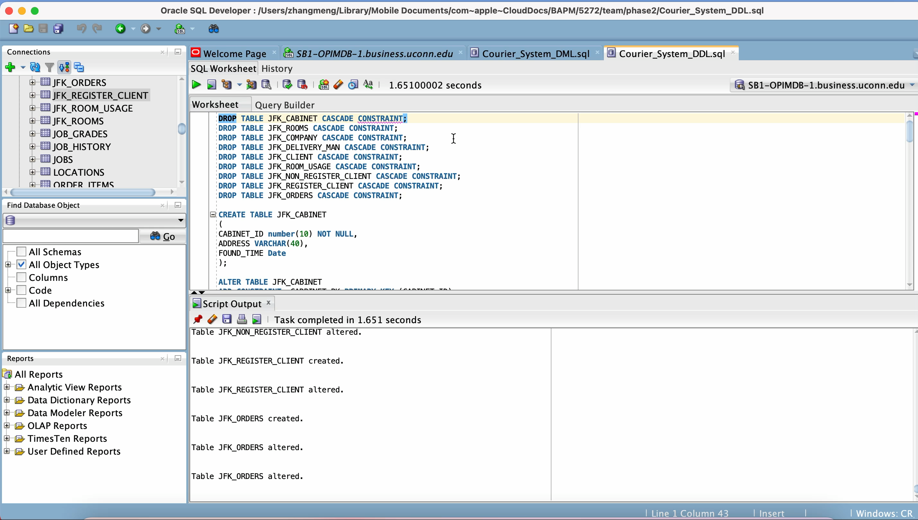
DEMO VIDEO

Slide 12
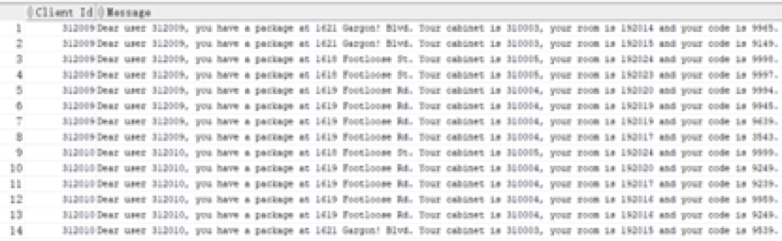
REPORTS SUMMARIES/EXAMPLES
Description:
JFK company needs to send message to these who register their official account. Also, they need to find out the client that JFK had not send message and edit messages for these users as the following format by using CLIENT_ID, CODE, CABINET ADDRESS, CABINET ID, ROOM ID.
Conclusion:
Clients will receive a message of where their packages have been delivered.
SQL Statement Code:
select cl.client_id AS "Client Id"
，'Dear user '|| cl.client_id || ', you have a package at ' || cb.address ||
'. Your cabinet is ' || cb.cabinet_id || ', your room is ' || rm.room_id ||
' and your code is ' || rm_usg.code || '.' AS "Message"
from JFK_REGISTER_CLIENT reg JOIN JFK_CLIENT cl
ON reg.register_client_id = cl.client_id
JOIN JFK_ROOM_USAGE rm_usg
ON cl.client_id = rm_usg.client_id
JOIN JFK_ROOMS rm
ON rm_usg.room_id = rm.room_id
JOIN JFK_CABINET cb
ON rm.cabinet_id = cb.cabinet_id
where reg.r_notification = 0
ORDER BY cl.client_id

Slide 13
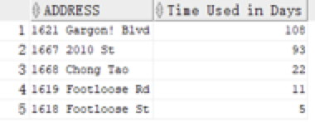
REPORTS SUMMARIES/EXAMPLES
Description:
JFK company want to know if there is relationship between cabinet address and used time for the rooms at certain address. They want to find out the total used time for rooms in each cabinet address and conclude that which address is most popular and which address second most popular and etc.
Conclusion:
Popularity of cabinets in different address:
1621 Gargon! Blvd > 1667 2010 St > 1668 Chong Tao > 1619 Footloose Rd > 1618 Footloose St
SQL Statement Code:
select TBA.ADDRESS, Round(SUM(TBA.TIME_USAGE)/(60*60*24)) AS "Time Used in Days"
from
(
select cb.address, round((to_date(to_char(TIME_OUT, 'yy-mm-dd hh:mi:ss'), 'yy-mm-dd hh:mi:ss') -to_date(to_char(TIME_IN, 'yy-mm-dd hh:mi:ss'), 'yy-mm-dd hh:mi:ss'))*24*60*60) AS "TIME_USAGE"
from JFK_ROOM_USAGE rm_usg JOIN JFK_ROOMS rm
ON rm_usg.room_id = rm.room_id
JOIN JFK_CABINET cb
ON rm.cabinet_id = cb.cabinet_id
) TBA
GROUP BY TBA.ADDRESS
ORDER BY 2 DESC;

Slide 14
THANKS!

